Slide 1
ANALYSIS OF CUSTOMER SATISFACTION BASED ON RECOMMENDATION STATUS
BY: PARVEJ ALAM M. ANSARI
DATE: 08-SEPTEMBER-2023

Slide 2
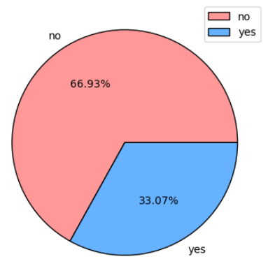


Customer Satisfaction
Almost 67 % Customers are not Satisfied with Services. What do they Say?
Food and beverages gets 1.8 average rating out of 5:
1. Time to deliver the order is too long
2. For free catering just bottle of water and a
packet of crisps
3. Minimal selection of food items for purchase.
Value for money gets 1.6 average rating out of 5:
1. The refund take a lot of time
2. Forced to use of vouchers however it was
useless
3. Long delay time
Recommends British Airways => 33.07 %
Does not Recommend British Airways => 66.93 %

